Slide 1
Introduction to AnyLogic Building Your First Model
Mohammad Ramshani
University of Tennessee

Slide 2
What We’ll Do ...
Install AnyLogic
Go over the software (briefly)
Introduce different components of the software
Make a simple model

Slide 3
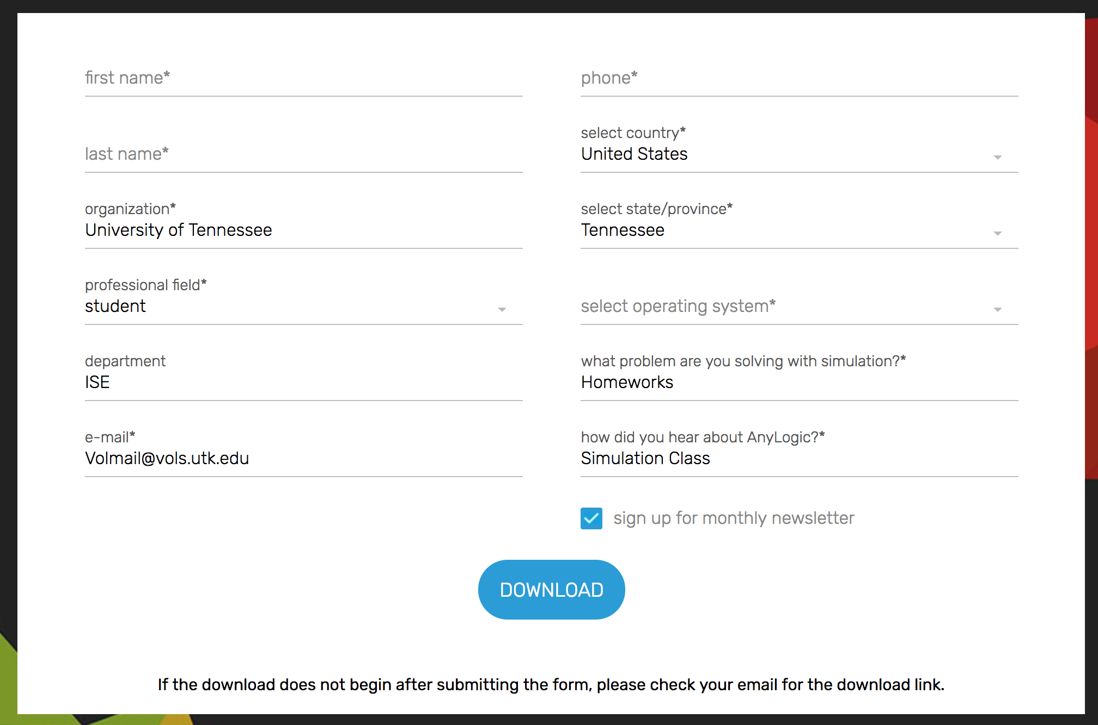
How to Install AnyLogic?
Guess?
Choose AnyLogic PLE (Personal Learning Edition)

Slide 4
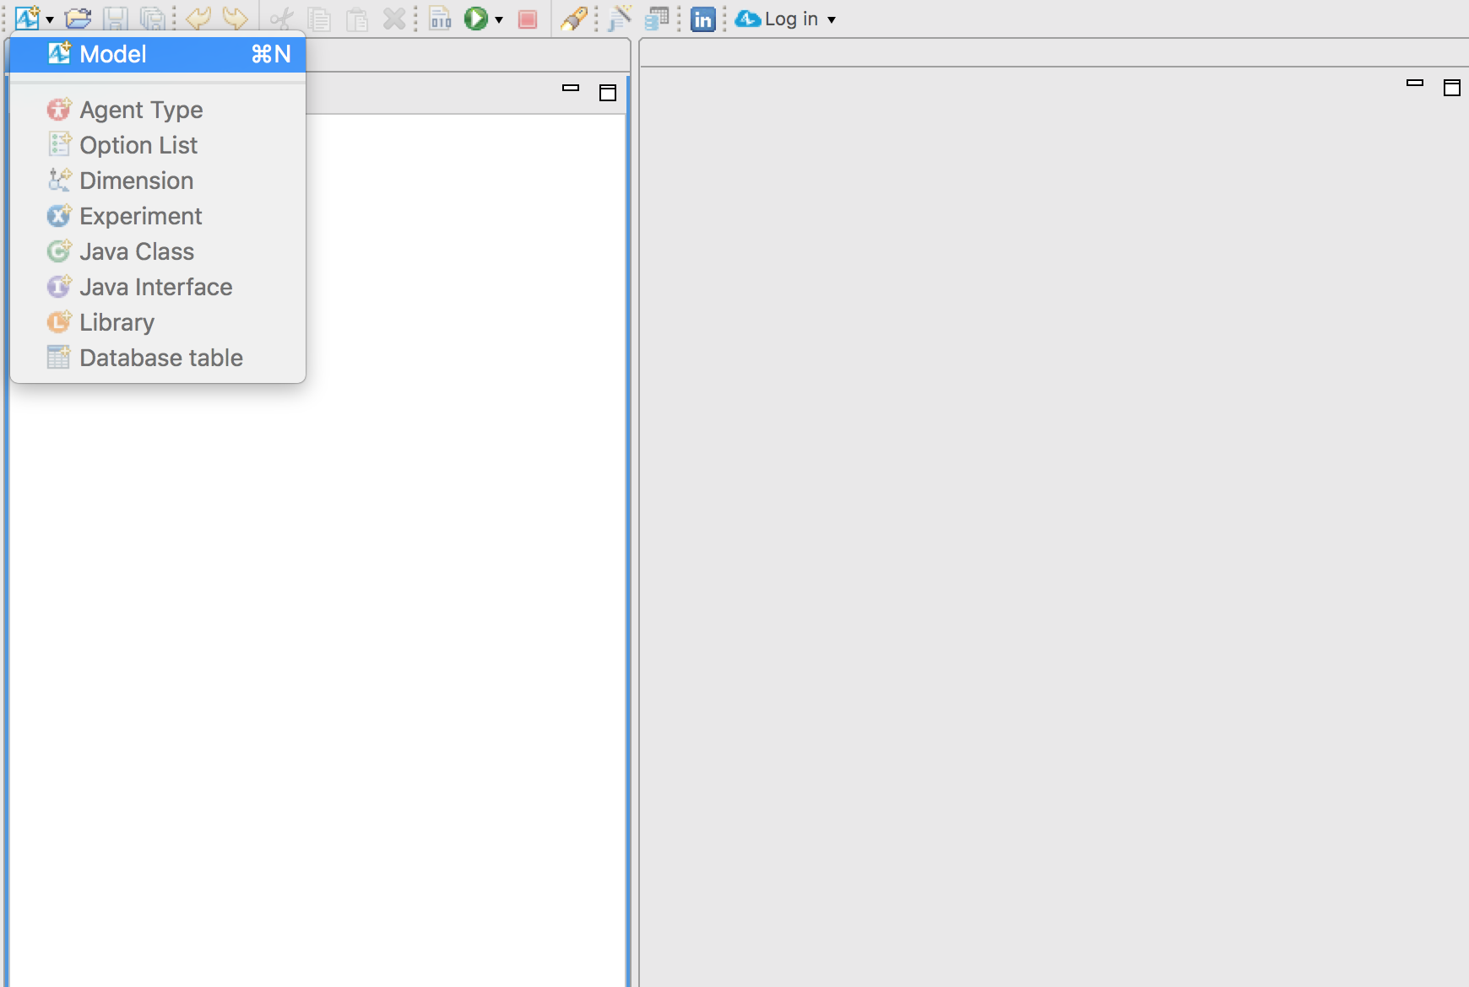
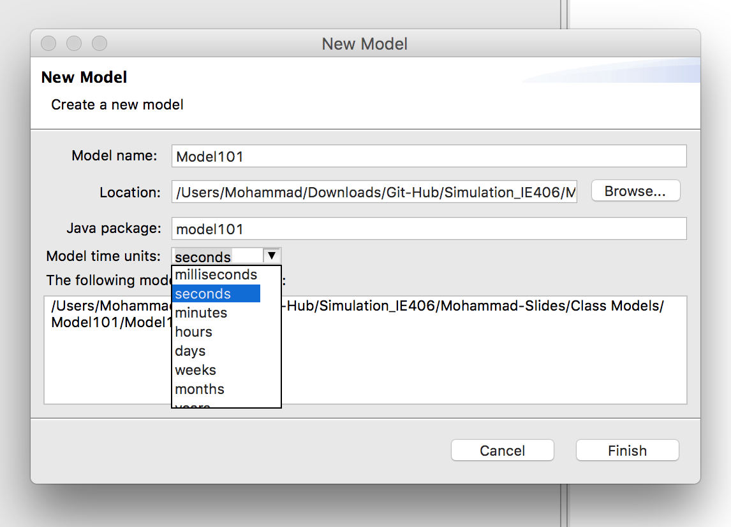
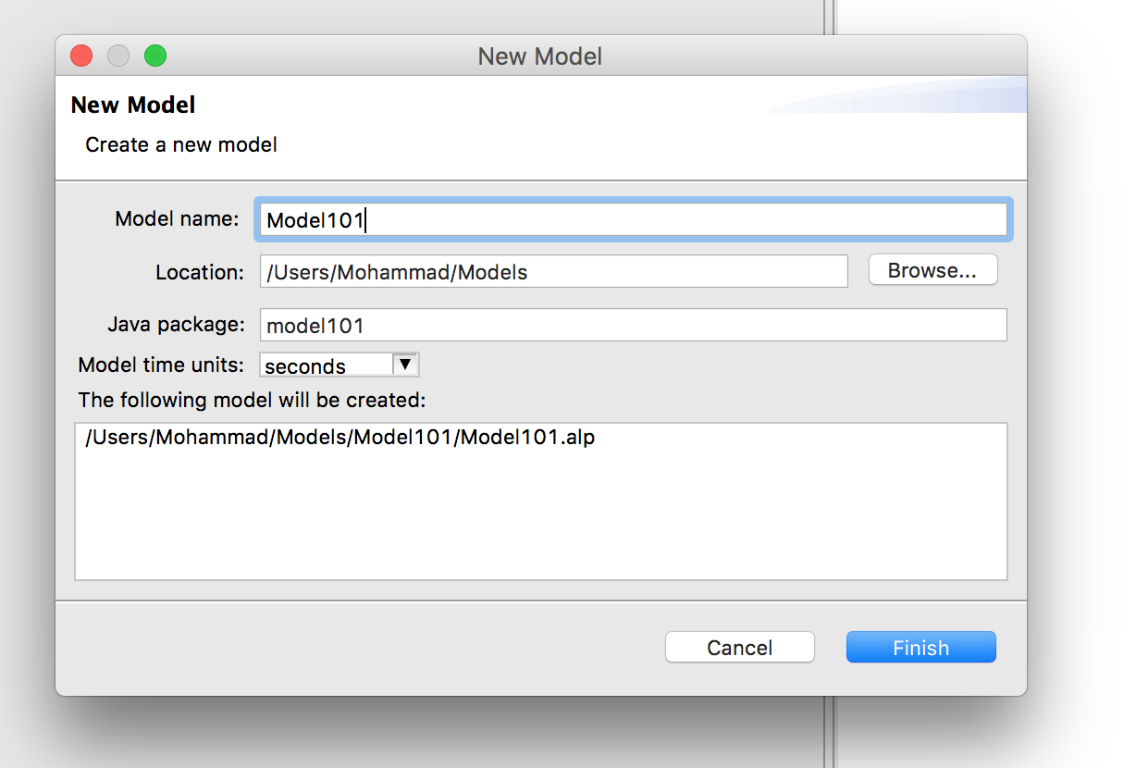
AnyLogic 101
Create a new model

Slide 5
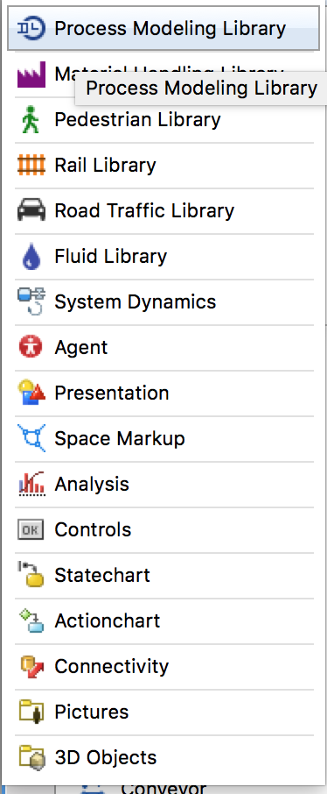
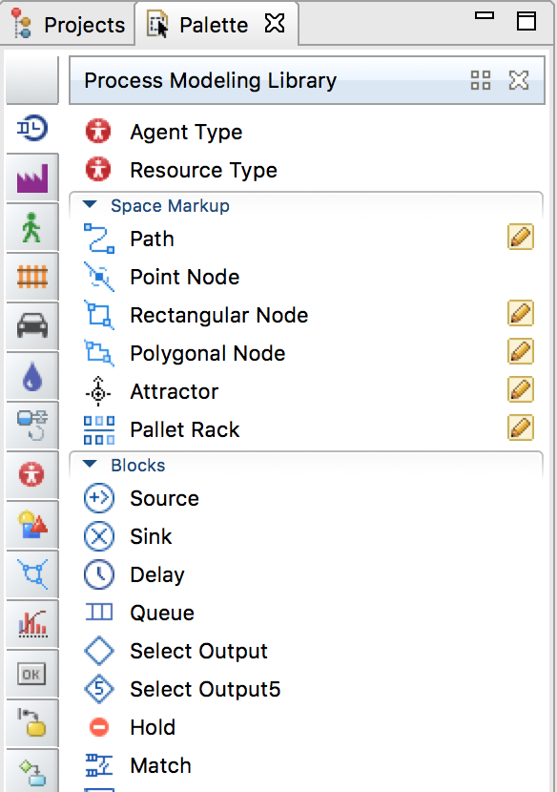
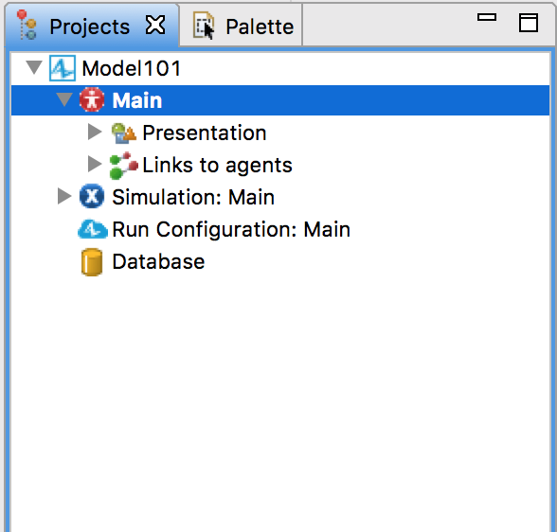
AnyLogic 101
Projects view
Palette view

Slide 6
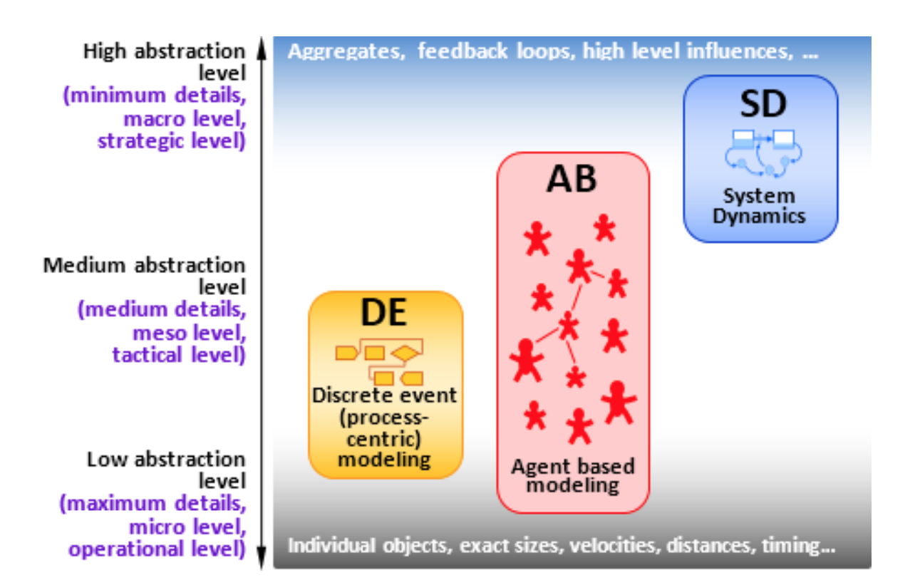
Scope the Problem!
Ask the right question
Understand the processes
Understand the level of granularity you need to work on

Slide 7
Case Study

